Slide 1
AI-Based Toxic Comment Detection System for Social Media
A Natural Language Processing project by Team members:
Samuel Raju (2403A54094) Ram Charan (2403A54101) Vishnu Vardhan (2403A54080)
Project guided by: Dr. Venkataramana V Presentation Date: J 8.02.2026.

Slide 2
Problem Statement
Growth of Facebook, Instagram, YouTube, and X
Increase in CyDerbuIIying and Hate speech
Inefficiency of manual moderation
Project Objectives
Develop real-time web detection application
Classify comments as Toxic or Non- Toxic
Display toxicity probability score and harmful words
Objectives

Slide 3


Slide 4
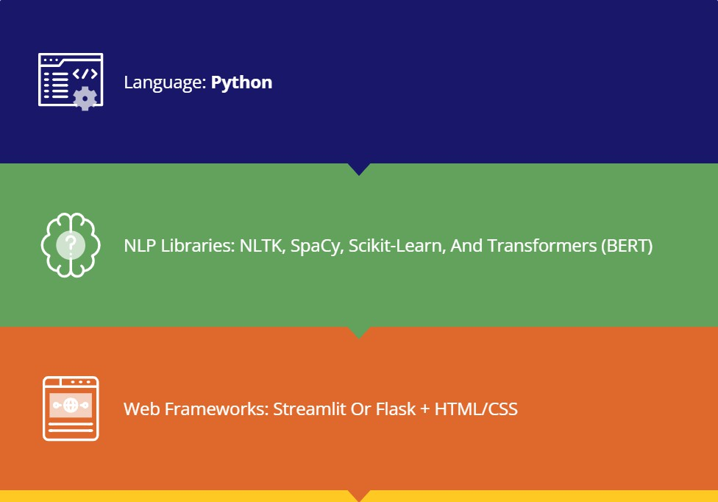

Programming Languages Tools and Software
Dataset & Tools: Kaggle Toxic Comment Dataset, VS Code, GitHub, And Postman

Slide 5
Comment Input Interface with Text Box and Analyze/Clear buttons
Front-End View of Web Application
Toxicity Score visualization with progress bar (Example: 879t)
Classification Result: Toxic / Non-Toxic labels
Highlighted harmful words such as "stupid", "hate™, and "idiot™

Slide 6
Thank You

